Slide 1



Session No.: -5 Course Name: Data Communication and Networking Course Code: R1UC406B Instructor Name: Gurmeet Singh
TCP/IP Protocol

Slide 2

Session Outline
RECAP : OSI Model Layers and its Description
Opening question and intended Learning Outcomes
A1 (PBL): Questions
A2:(Think Pair Share)
Conclusion: Key takeaways
What’s next ?

Slide 3
Recap
Purpose of Reference Models in Data Communication • Role of ISO and introduction to the OSI model • Seven layers of OSI model and their responsibilities
Physical Layer – Transmission of bits • Data Link Layer – Frame delivery & error detection • Network Layer – Packet routing and addressing • Transport Layer – Process-to-process delivery • Session Layer – Dialog control & synchronization • Presentation Layer – Translation, compression, encryption • Application Layer – Services to end users

Slide 4
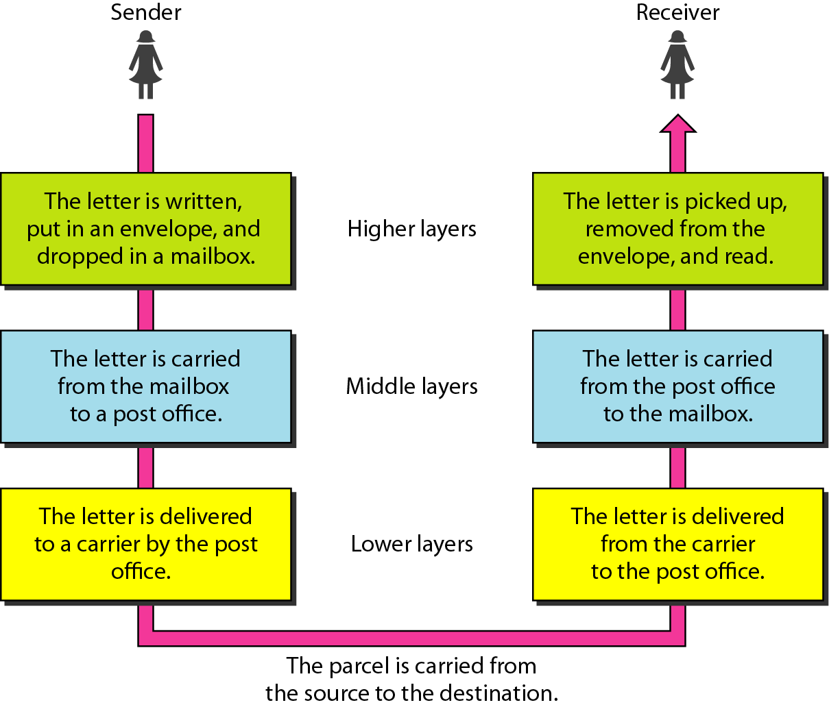
REVISITING ACTIVITY FROM PREVIOUS LESSON

Slide 5
Let’s think
Do real networks strictly follow all 7 OSI layers?
If OSI is a reference model, which model is used in real networks like the Internet?
We may consider the following:
• OSI model is a conceptual/reference framework used mainly for learning and standardization • Real networks do not strictly implement all 7 OSI layers separately • Some OSI layers are merged or combined in practical implementations • OSI helps us understand “how communication should work”, while TCP/IP shows “how it actually works”

Slide 6
At the end of this session students will be able to,
LO 1:List and describe the four layers of the TCP/IP model along with their primary functions.
LO 2:Compare the TCP/IP model with the OSI reference model in terms of structure and practical implementation.
Notes:
To understand the difference between these situations, we will go through today’s lesson

Slide 7

Activity 1:
What are the four layers of the TCP/IP model and their functions?
Answer:
The four layers of the TCP/IP model are:
Network Access Layer (Link Layer) – Handles physical transmission of data (Ethernet, Wi-Fi, MAC addressing).
Internet Layer – Provides logical addressing and routing (IP, ICMP, ARP).
Transport Layer – Ensures end-to-end communication (TCP for reliability, UDP for speed).
Application Layer – Supports user-facing applications (HTTP, FTP, SMTP, DNS).

Slide 8
The TCP/IP (Transmission Control Protocol/Internet Protocol) model is the fundamental communication protocol of the Internet and most computer networks. It enables devices to communicate with each other by defining how data should be packetized, addressed, transmitted, routed, and received.

Slide 9
TCP/IP is a suite of communication protocols that governs how data is transmitted across networks, including the Internet. It provides an end-to-end connection that specifies how data should be formatted, addressed, transmitted, and received.
TCP (Transmission Control Protocol) ensures reliable data transmission by establishing a connection before sending data and ensuring that all packets arrive correctly.
IP (Internet Protocol) is responsible for addressing and routing packets to their destination.

Slide 10
Layers of TCP/IP Model
The TCP/IP model consists of four layers, which correspond to the OSI (Open Systems Interconnection) model's seven layers.
TCP/IP Layer | Equivalent OSI Layers | Function
1. Network Access Layer | Physical + Data Link | Deals with the hardware transmission of data over physical media.
2. Internet Layer | Network Layer | Handles addressing, routing, and packet forwarding.
3. Transport Layer | Transport Layer | Ensures reliable or connectionless communication between devices.
4. Application Layer | Application + Presentation + Session | Provides network services to end-users, such as HTTP, FTP, and DNS.

Slide 11
Layer 1: Network Access Layer (Link Layer)
Responsible for physically transmitting data over the network medium.
Defines protocols for accessing physical transmission media (Ethernet, Wi-Fi, etc.).
Ensures frame synchronization, error detection, and MAC (Media Access Control) addressing.
Examples of protocols in this layer:
Ethernet
Wi-Fi (802.11)
ARP (Address Resolution Protocol)
PPP (Point-to-Point Protocol)

Slide 12
Layer 2: Internet Layer
Responsible for addressing and routing packets across networks.
Uses the IP (Internet Protocol) to ensure packets reach the correct destination.
Includes mechanisms for packet fragmentation and reassembly.
Key protocols:
IP (Internet Protocol): Defines IP addresses and handles routing.
ICMP (Internet Control Message Protocol): Used for network diagnostics (e.g., ping command).
ARP (Address Resolution Protocol): Resolves IP addresses to MAC addresses.
RARP (Reverse Address Resolution Protocol): Resolves MAC addresses to IP addresses.

Slide 13
Layer 3: Transport Layer
Ensures end-to-end communication between devices.
Uses two major protocols:
TCP (Transmission Control Protocol): Reliable, connection-oriented communication.
UDP (User Datagram Protocol): Fast, connectionless communication.
Key functions of the Transport Layer:
Segmentation and Reassembly: Breaks large data into smaller segments and reassembles them at the destination.
Flow Control: Prevents overwhelming the receiver.
Error Detection & Correction: TCP ensures correct delivery through acknowledgments.
Feature | TCP (Transmission Control Protocol) | UDP (User Datagram Protocol)
Reliability | Ensures delivery, retransmits lost packets | No retransmission, best effort
Connection Type | Connection-oriented (requires a handshake) | Connectionless
Speed | Slower due to error checking and acknowledgment | Faster, no error checking
Use Case | Web browsing, file transfer, emails | VoIP, live streaming, online gaming

Slide 14
Layer 4: Application Layer
Provides network services directly to users.
Includes protocols for web browsing, email, file transfers, etc.
Protocol | Purpose | Protocol
HTTP/HTTPS (Hypertext Transfer Protocol) | Web browsing | HTTP/HTTPS (Hypertext Transfer Protocol)
FTP (File Transfer Protocol) | File transfer | FTP (File Transfer Protocol)
SMTP (Simple Mail Transfer Protocol) | Sending emails | SMTP (Simple Mail Transfer Protocol)
POP3/IMAP | Retrieving emails | POP3/IMAP

Slide 15
Working of TCP/IP Model
Step-by-step Data Transmission Process
Application Layer: The user sends data using an application (e.g., a web browser).
Transport Layer: TCP divides the data into segments and adds sequence numbers for reliability.
Internet Layer: IP assigns the source and destination IP addresses and routes the packets.
Network Access Layer: Converts packets into frames and transmits them over the physical medium.
At the Receiver’s End: The process is reversed to reconstruct the original message.
Example: Sending a Web Request
A user enters "www.example.com" in a browser.
DNS resolves the domain to an IP address.
HTTP sends the request.
TCP breaks the request into segments.

Slide 16
Comparison of TCP/IP vs OSI Model
Feature | TCP/IP Model | OSI Model
Number of Layers | 4 | 7
Developed By | DoD (Department of Defense) | ISO (International Organization for Standardization)
Usage | Used in real-world networks, including the Internet | Theoretical model for networking
Reliability | Provides error handling via TCP | Provides error checking at multiple layers

Slide 17
Activity 2:
A student opens a web browser and types www.google.com and presses Enter.
Which TCP/IP layers are involved in this communication?
Name one protocol used at each layer.
Which OSI layers are merged into the TCP/IP Application layer?
Students compare and refine their answers and complete the table:
TCP/IP Layer | Key Function | Example Protocol | Corresponding OSI Layers
Application
Transport
Internet
Network Access
Share your Responses

Slide 18
Conclusion
The TCP/IP model is the backbone of modern networking, enabling seamless communication between devices worldwide. It ensures data transmission, error checking, and proper addressing, making it essential for applications like web browsing, email, and file sharing. Understanding its layered architecture helps in troubleshooting network issues and designing efficient communication systems.

Slide 19
LO attainment: Please Check, if you are now able to
LO 1: Create and manipulate NumPy arrays for numerical computations
LO 2: Perform basic operations and reshape arrays to prepare data for ML workflows
Notes:
To understand the difference between these situations, we will go through today’s lesson

Slide 20
Post-lesson discussion
Which TCP/IP layer do you think is the most critical for Internet communication? Why?
What could happen if the Transport Layer fails to ensure reliability?
In the TCP/IP model, what exactly is being transmitted at each layer — data, segments, packets, or frames?
How does TCP/IP handle data before sending it over the physical medium?
Why is it important to convert application data into signals for transmission?
Notes:
Brief about the case 1-2 mins
Discuss and prepare to slide into the need for Pandas in Python for ML

Slide 21
Information to next topic of the course
DATA AND SIGNALS: Analog and Digital Data, Analog and Digital Signals, Periodic and Nonperiodic Signals

Slide 22

Review and Reflection from students

